Slide 1
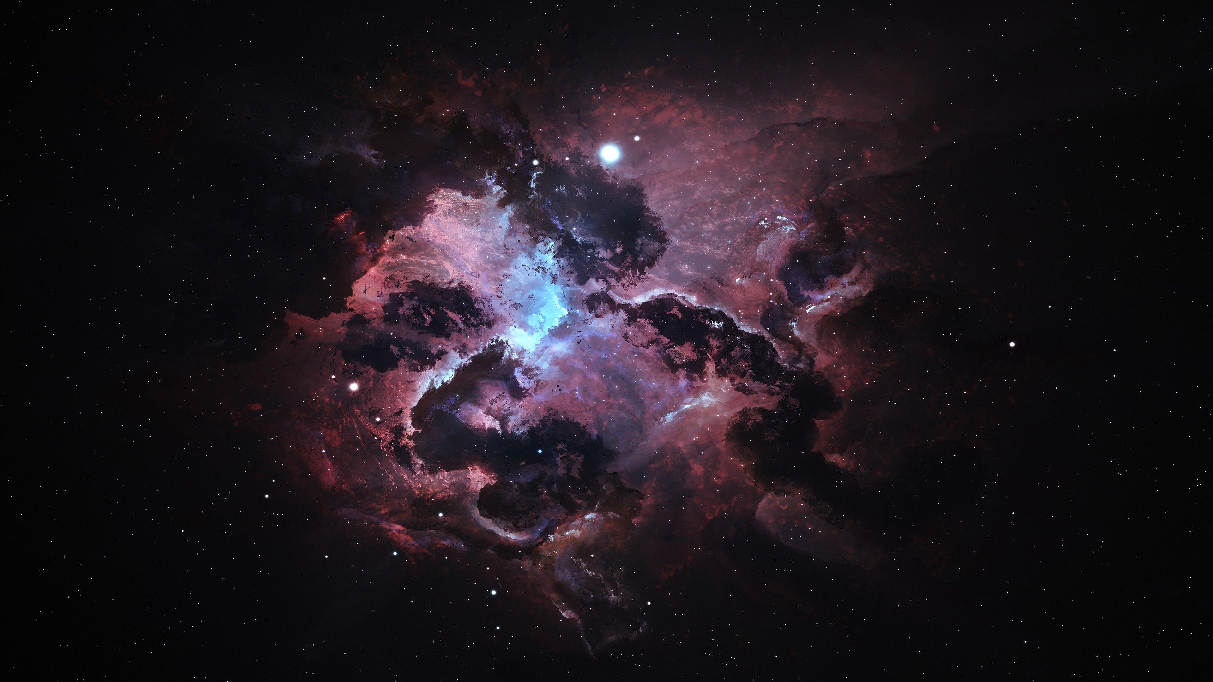
The Life Cycle of a Star: From Nebula to Supernova
The Stellar Journey
An Animated Look at Cosmic Evolution

Slide 2
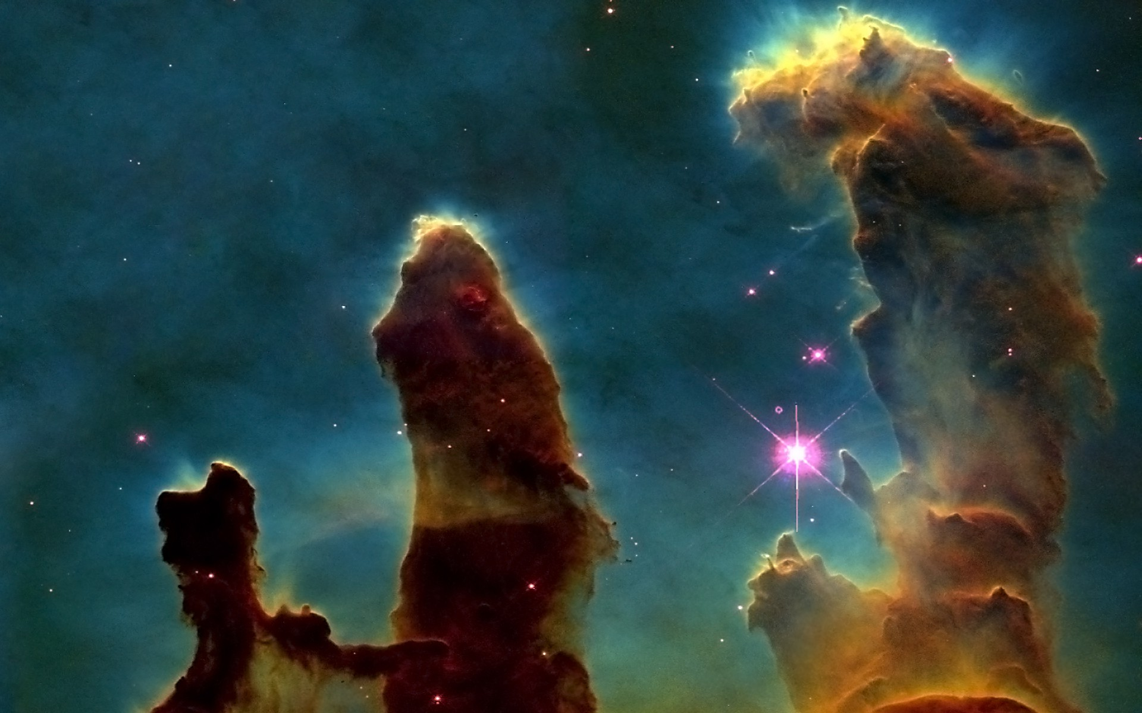
Nebula: The Stellar Nursery
Stellar Birth
Stars are born from vast clouds of gas and dust called nebulae.
The immense force of gravity is the primary engine of star formation, pulling gas and dust together.
This material collapses and heats up, forming a dense core known as a protostar.
This early stellar core is not yet a true star; it's too cool for nuclear fusion to begin.
Star birth is an incredibly slow process, taking millions of years for a protostar to ignite and become a main-sequence star.
If the collapsing material doesn't have enough mass, it can't ignite fusion and instead becomes a brown dwarf or "failed star."

Slide 3
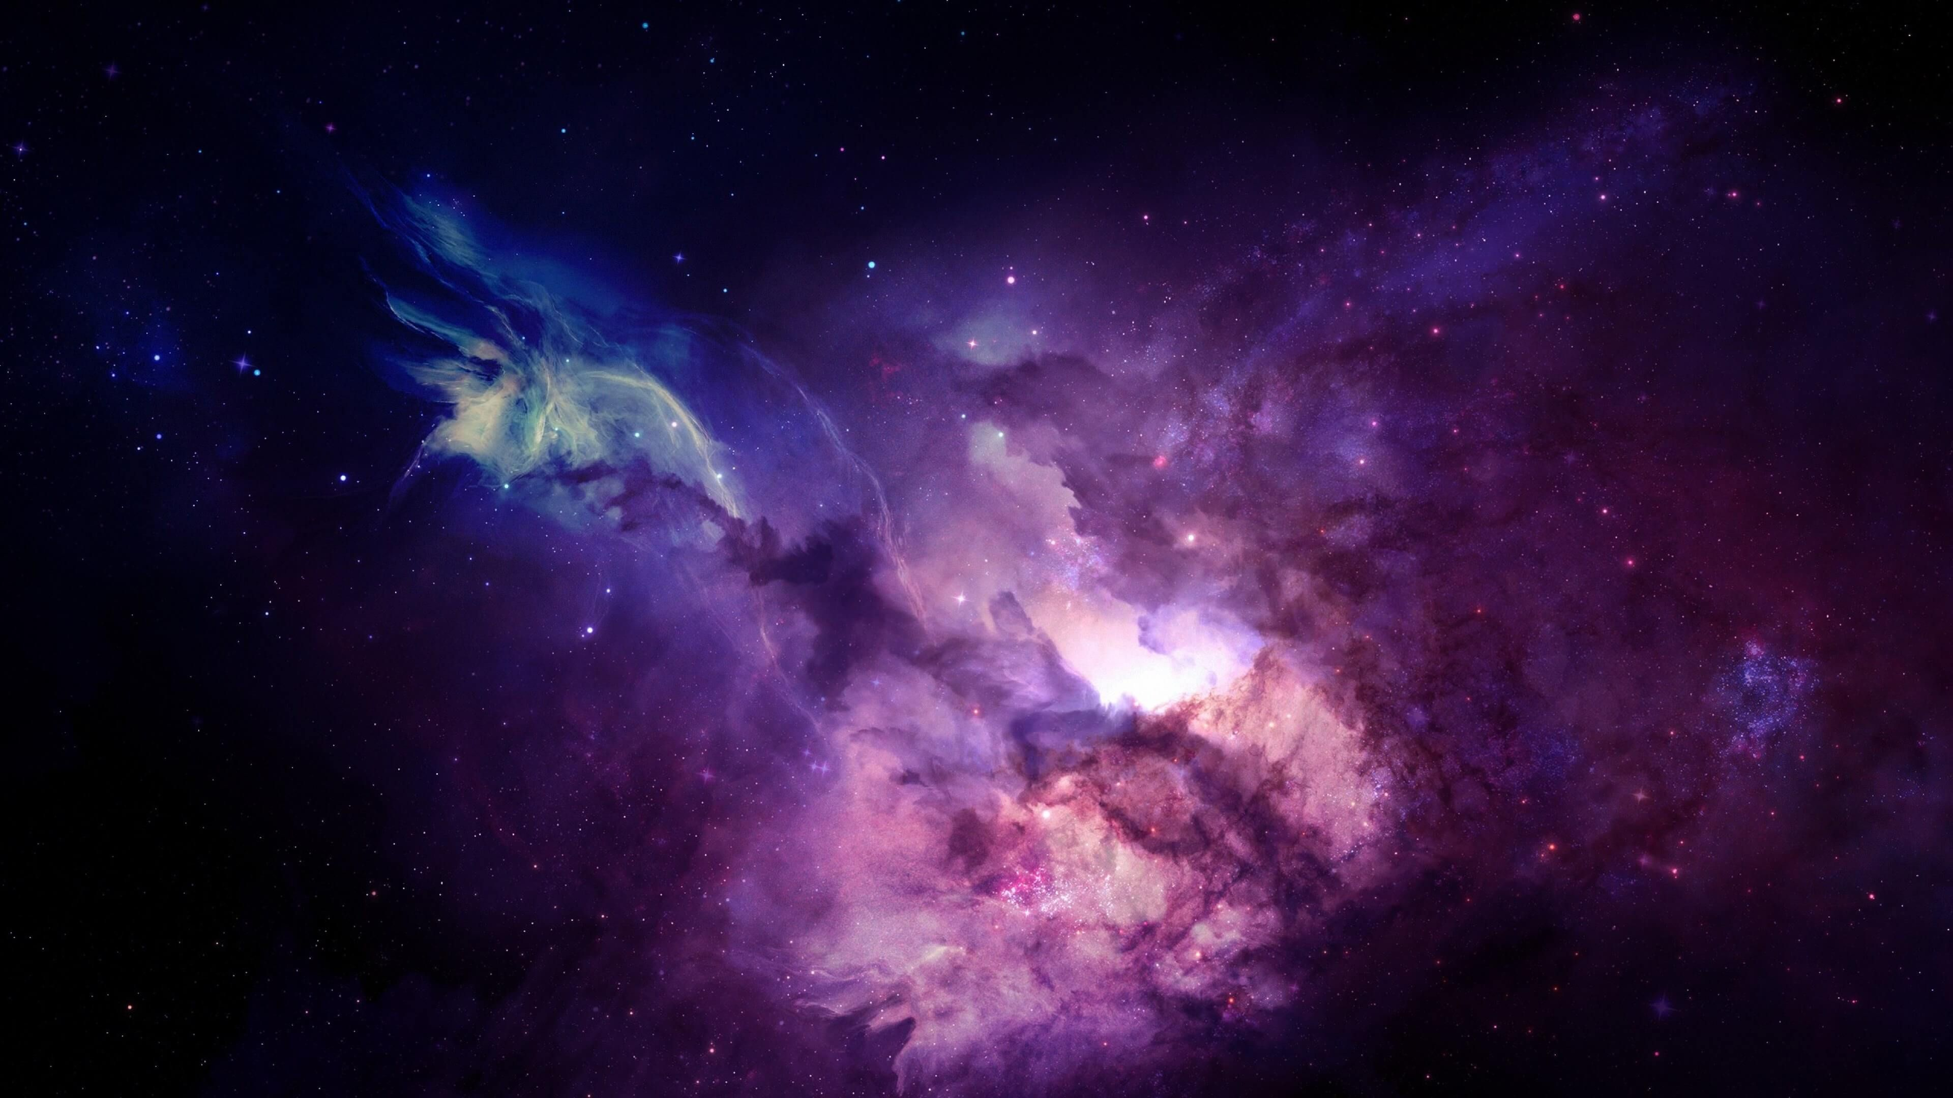
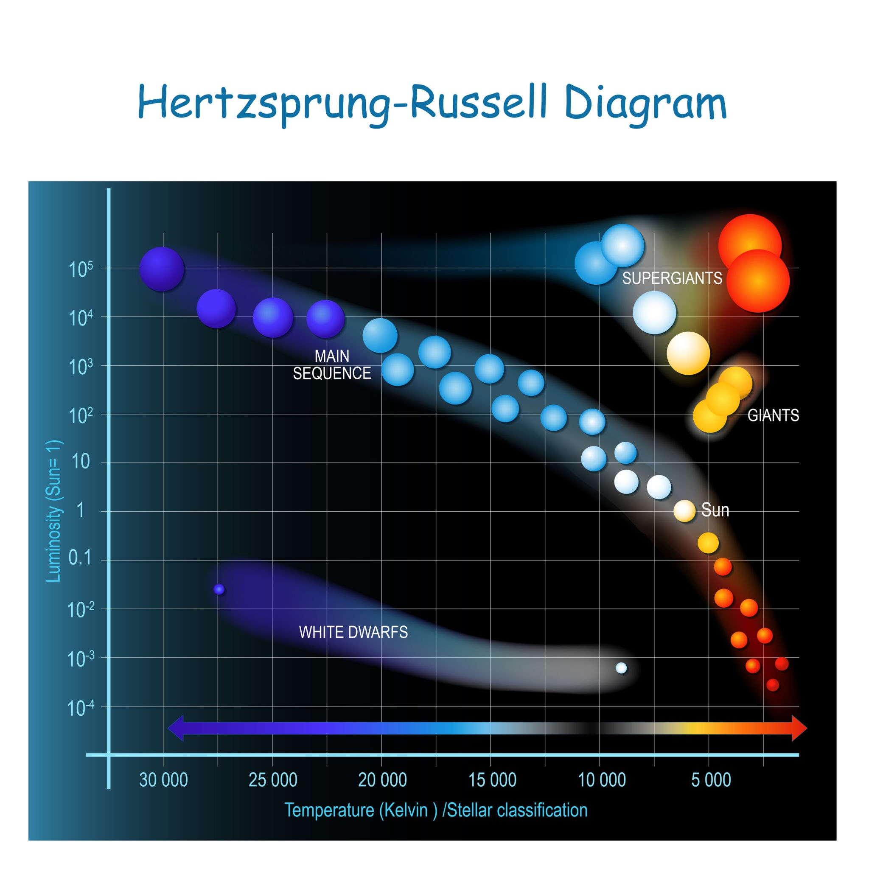
The Long, Stable Life
Main Sequence
Star Type | Example | Lifespan | Primary Fuel
Small Star | The Sun, Proxima Centauri | ~10 billion years | Hydrogen fusion (slow)
Large Star | Rigel, Betelgeuse | ~10 million years | Hydrogen fusion (fast)

Slide 4
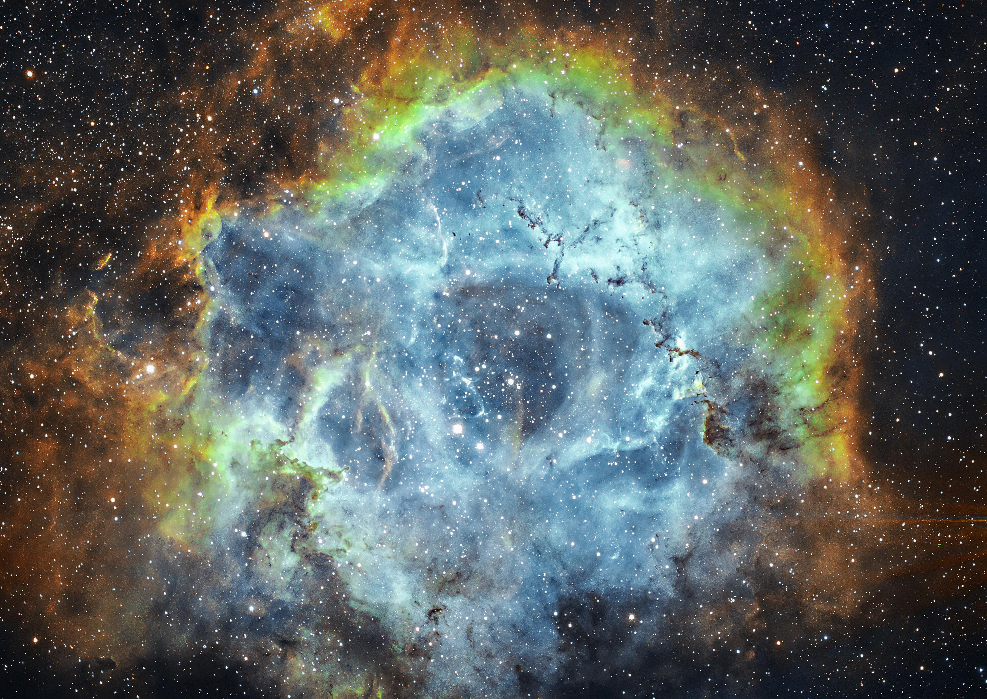
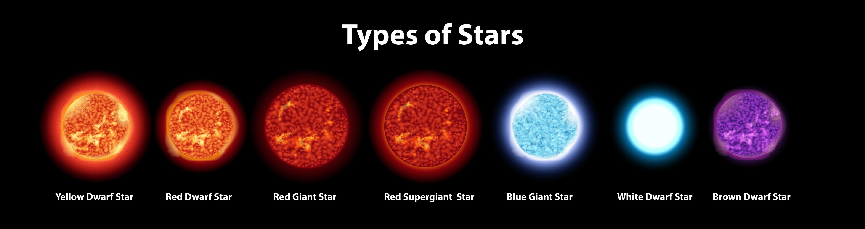
The Two Paths of Death
Stellar Demise
Path 1: Low-Mass Star (The Whisper):
Path 2: High-Mass Star (The Bang):
Planetary Nebula
White Dwarf
Supernova
Neutron Star/Blackhole

Slide 5
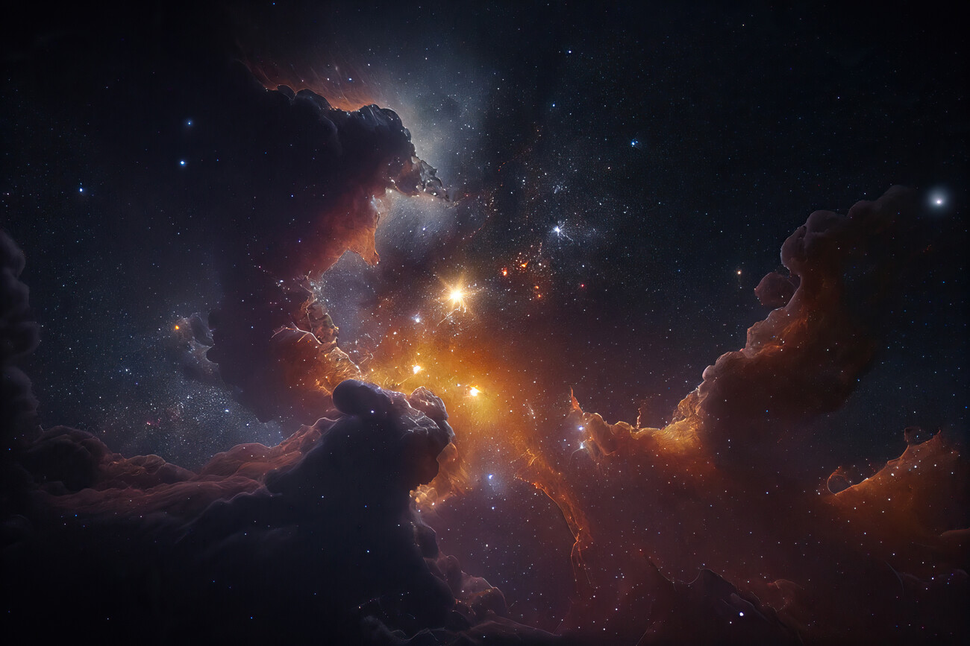
Cosmic Recycling - A New Generation
Cosmic Legacy.
Supernovae explosions scatter heavy elements (like Carbon, Oxygen, and Iron) into space.
These elements become the building blocks for new stars, planets, and even life.
The death of one star directly feeds the birth of the next generation of celestial objects.
THANK YOU!
Thank You! | For more info:https://cosmicopia.gsfc.nasa.gov/nucleo.html

